Slide 1


T KLS GOGTE INSTITUTE OF TECHNOLOGYGO DEPARTMENT OF MECHANICAL ENGINEERING
TEAM MEMBERS – SAMARTH MAIDARAGI -2GI17ME113
SUMEDH DESAI -2GI17ME148
SURAJ KUMAR B K -2GI17ME150
VISHAL KHANAGAVI -2GI17ME165
GUIDE – Prof. VIVEK TIWARY

Slide 2
INVESTIGATIONS ON THE EFFECT OF NYLON MICROPARTICLES ON FRICTION STIR WELDING OF A 3D PRINTED POLYMER COMPONENTS

Slide 3
CONTENTS
Abstract
Literature Review
Applications
Objectives of Study
Methodology
References

Slide 4
Abstract
Due to the bed size limitation of a commercially available 3D Printer it is difficult to fabricate a larger part by 3D Printing Technology. Hence to circumvent this issue joining of the 3D printed parts by Friction stir welding has been attempted in this project. Further, the welding section was enhanced with nylon microparticles with an objective to improve the joint strength. To confirm the results, mechanical tests including tensile and hardness were performed on the weld section.

Slide 5
Literature Review
SL.NO | AUTHOR | YEAR | TITLE | PROMINENT FINDINGS
1 | Bandari Vijendra, Abhay Sharma | 2015 | Induction heated tool assisted friction-stir welding (i-FSW) | Microstructural examination revealed that, the strength of the friction-stir welded joint will be close to that of the base material if the overall width of the transition zone is small with less complex morphology.
2 | Z. Sun, C.S. Wu | 2018 | A numerical model of pin thread effect on material flow and heat generation in shear layer during friction stir welding | The results show that when tool rotates in counter-clockwise direction, a right-hand threaded pin can push the material near the pin side to flow downward, which causes an upward motion of an equivalent amount of material near the border of the shear layer.
3 | Shayan Eslami, Tiago Ramos, Paulo J. Tavares, P.M.G.P. MoreiraI | 2015 | Shoulder design developments for FSW lap joints of dissimilar polymers. | The possible probe geometry of the FSW Tool for Polycarbonate is Cylindrical.

Slide 6
SL.NO | AUTHOR | YEAR | TITLE | PROMINENT FINDINGS
4 | Karen J. Quintana, Jose Luis L. Silveira | 2017 | Mechanistic models and experimental analysis for the torque in FSW considering the tool geometry and the process velocities | The highest torque value was observed in the plunging phase; therefore, to determine the machine capacity and to design properly the tools for the process, the plunging is the most important phase and the factors that influenced the critical torque value in the FSW are the tool geometry, and the plunging and rotational speeds.
5 | S Inaniwa, Y Kurabe, Y Miyashita, H Hori. | 2013 | Application of friction stir welding for several plastic materials | Difference in strength of the joint showed the same trend with difference in hardness at the stir zone in comparison of materials used. It was considered that the joining strength depends on both the degradation of mechanical property and the voids formed at the welded area.

Slide 7
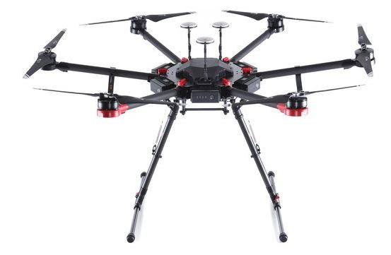
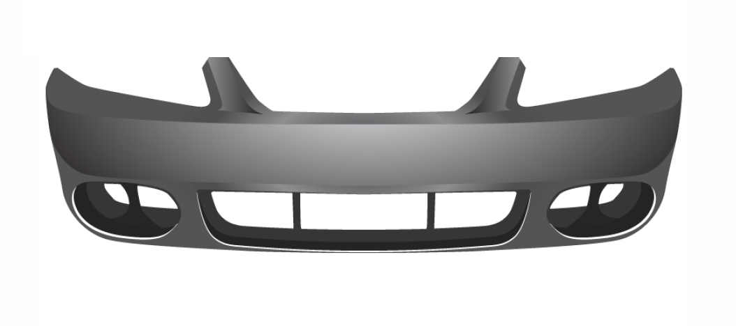
Applications
Fig 1.1 3D Printed car bumper
Fig 1.2 3D Printed Hexa copter

Slide 8
Objectives of Study
To fabricate a larger part overcoming the limitation of bed size of 3D printing.
To incorporate Friction Stir Welding(FSW) to join the two 3D printed parts.
To observe the effect of Nylon Microparticles over the joints performed by FSW process.
To perform the mechanical tests like Tensile test, hardness and prepare DOE table of the outcomes.

Slide 9
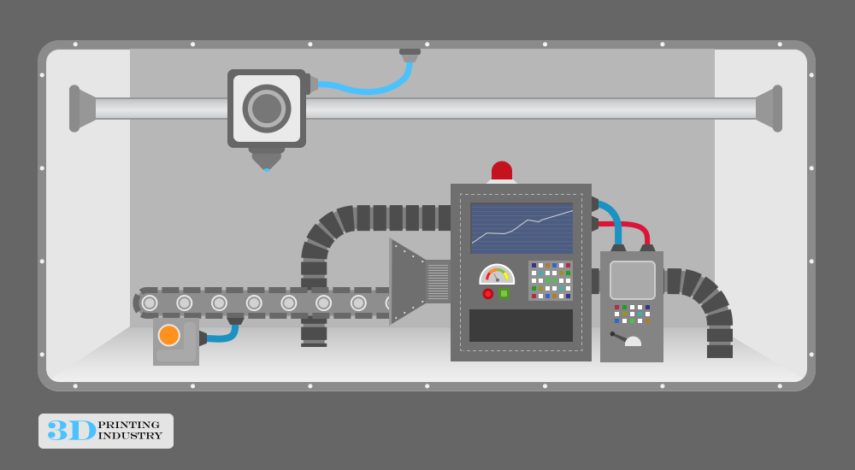
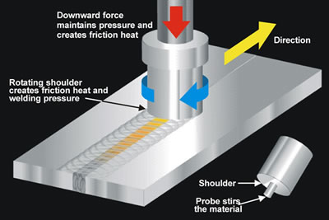
Methodology
3d Printing
Friction Stir Welding

Slide 10
Methodology
Tool rotational speed – Tool rotational speed plays a very important role during FSW of thermoplastics. An optimum tool rotation would result in sufficient material flow, creating a proper stirring action, generating a high amount of heat and finally a good weld.
Tool traverse speed – An optimum traverse speed controls the time duration of tool–workpiece interaction, controlling the heat input and finally affecting the crystallinity and resultant properties of the weld. It is also observed that this parameter affects the microstructure and the surface finish of
the welded parts.

Slide 11
Methodology
Tool pin taper angle – Among the various tool geometries available (tool pin length, pin diameter, pin profile, pin taper angle, shoulder concavity angle, and shoulder diameter), tool pin taper angle plays a significant role determining the weld strength.
Infill – Infill is a very important parameter during 3D printing, which regulates the density of internal fillings of the polymeric parts. The main objective of this study being joining of 3D printed polymers by the FSW technique, an end-user might not always go for 100% infill printing.

Slide 12
References
Induction heated tool assisted friction-stir welding (i-FSW).
-Bandari Vijendra, Abhay Sharma
A numerical model of pin thread effect on material flow and heat generation
in shear layer during friction stir welding.
-Z. Sun, C.S. Wu
Shoulder design developments for FSW lap joints of dissimilar polymers.
-Shayan Eslami, Tiago Ramos, Paulo J. Tavares, P.M.G.P. MoreiraI
Mechanistic models and experimental analysis for the torque in FSW considering the tool geometry and the process velocities
-Karen J. Quintana, Jose Luis L. Silveira
Application of friction stir welding for several plastic materials
-S Inaniwa, Y Kurabe, Y Miyashita, H Hori.

Slide 13
Thank you.

